Slide 1

SystemVerilog Lab 3 Single-Cycle Processor Part 2
Computer Architecture and Assembly Language – Fall 2024
By:
Eng. Alaa Mohamed – Eng. Mohamed Ali

Slide 2
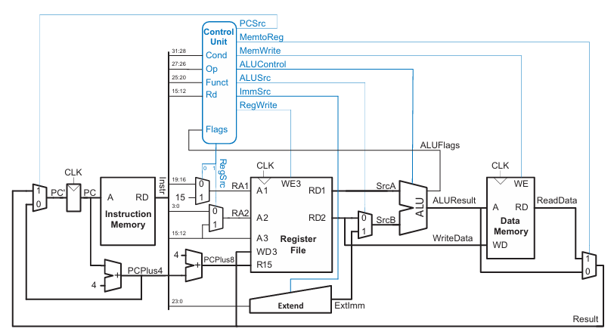
Single-Cycle Processor

Slide 3
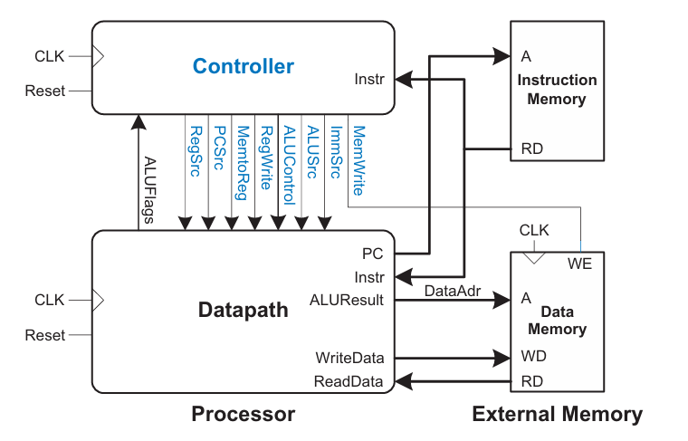
Single-Cycle Processor HDL
Top

Slide 4
Single-Cycle Processor Integration
Top

Slide 5
Datapath

Slide 6
Single Cycle Processor Datapath
Top
6

Slide 7
Building Modules
These parameterized modules are either previously done or given:
2-to-1 Multiplexer
Resettable Flip-flop
Adder
ALU (ADD, SUB, AND, ORR)
This lab task include implementing the following modules:
Extender
Register File
It is also required to integrate the modules to make the datapath module.

Slide 8
Extender

Slide 9
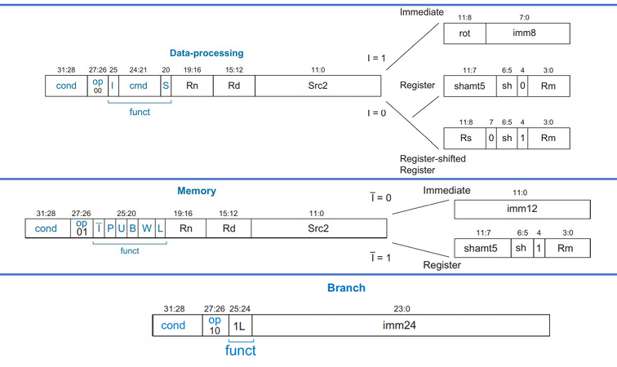
Extender: Immediate Src2
1
2
3

Slide 10
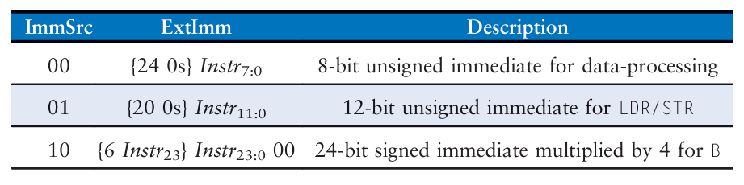
Extender: Immediate Src2
1
2
3

Slide 11
Register File

Slide 12
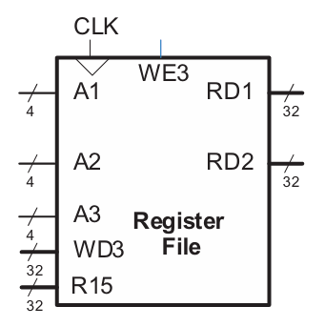
Register File Specs
Contains fifteen 32-bit register (2D array).
Read operation is done combinationally, while write operation is done at the rising edge of the clock.
Input ports:
clk
A1: read address 1
A2: read address 2
A3: write address
WD3: write data
WE3: write enable
R15: special for reading PC+8

Slide 13
Register File Specs
Contains fifteen 32-bit register (2D array).
Read operation is done combinationally, while write operation is done at the rising edge of the clock.
Output ports:
RD1: read data 1
RD2: read data 2

Slide 14
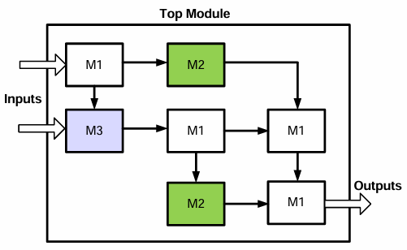
Recap: Sub-Modules Instantiation
A design can use multiple submodules or a module multiple times.
Using a module in another is called “instantiation”.
To use a module inside another, it should be explicitly instantiated.

Slide 15
Recap: Sub-Modules Instantiation
To instantiate a module, two things have to be clearly specified:
Module’s ports
Module’s parameters (considered as default if not specified)
Named Assignment format:
Module_name #(parameter_value) instance_name (.port_name(port-connection), .port_name(port-connection),….)
Ordered Assignment format:
Module_name #(parameter_value) instance_name (port-connection, port-connection,….)
Example: flopenr #(2) flagreg0 (clk, reset, FlagWrite[0], ALUFlags[1:0], Flags[1:0]);

Slide 16
Controller

Slide 17
Single-Cycle Processor Controller
Top

Slide 18
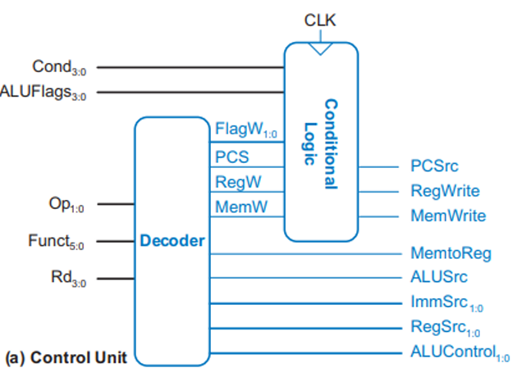
Control Unit

Slide 19
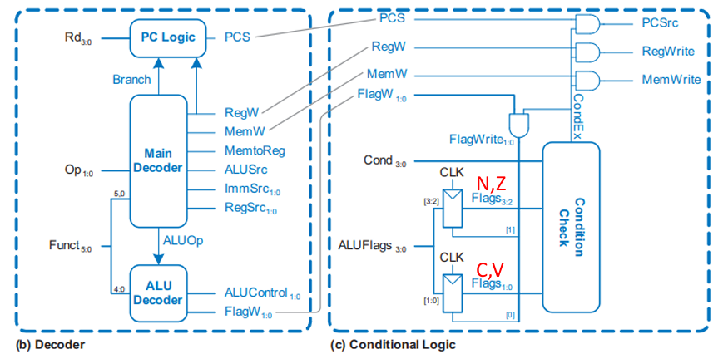
Control Unit

Slide 20
Building Modules
These modules are given:
Resettable Flip-flop with Enable
Conditional Logic
ALU Decoder
PC Logic
Controller (top-level module)
This lab task include implementing the following modules:
Conditional Check
Main Decoder (inside decoder module)

Slide 21

Conditional Check
Inputs:
Cond (4 bits)
Flags (4 bits) → (N, Z, C, V)
Output:
CondEx (1 bit)
The module checks whether to update (write) the destination register based on the condition mnemonic and saved flags.

Slide 22
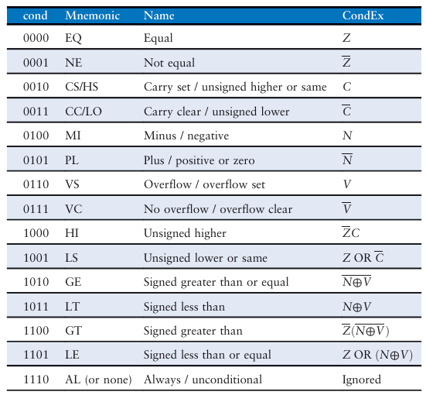
Conditional Check
Inputs:
Cond (4 bits)
Flags (4 bits) → (N, Z, C, V)
Output:
CondEx (1 bit)
The module checks whether to update (write) the destination register based on the condition mnemonic and saved flags.

Slide 23
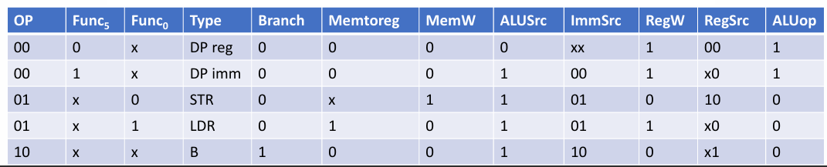
Main Decoder
Inputs
Outputs

Slide 24
Instruction and Data Memories

Slide 25
Single-Cycle Processor Integration
Top

Slide 26
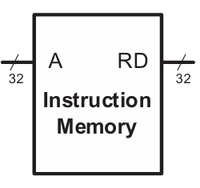
Instruction Memory (64 * 32 bits)
The test program instructions’ machine code is stored in a hexadecimal file called memfile.dat.
The instruction memory module reads this file and outputs the instruction based on the value of PC (input).
PC increases by 4 in hardware, while array index
should increase by 1 in SystemVerilog module.
Word alignment acts as a two-bit right shifter
(dividing by 4) as follows:
assign rd = RAM[a[31:2]];

Slide 27
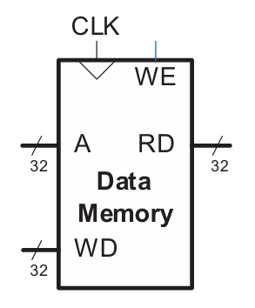
Data Memory (64 * 32 bits)
Read operation is done combinationally, while write operation is done at the rising edge of the clock.
Word alignment should be applied on input address.
Inputs:
Clk
WE (1 bit) → write enable
A (32 bits) → read or write address
WD (32 bits) → write data
Output:
RD (32 bits) → read data

Slide 28
Top Level Module

Slide 29
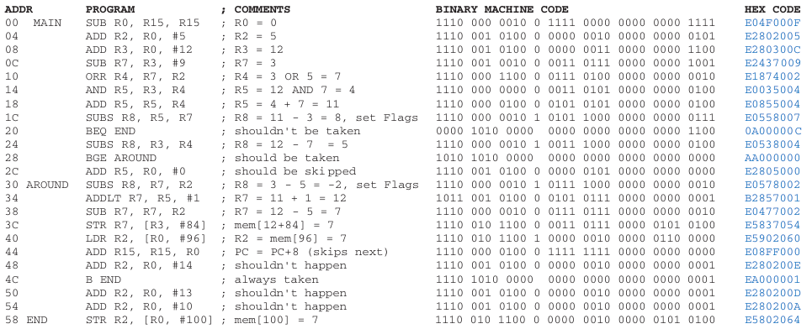
Testbench
The program, stored in instruction memory, exercises hardware by performing a computation that should produce the correct result only if all of the instructions are functioning correctly.
Specifically, the program will write the value 7 to address 100 if it runs correctly, but it is unlikely to do so if the hardware is buggy.

Slide 30
Testbench
TB
Top
Drive inputs
Observe outputs

